Slide 1
DFT calculations of motional effects on NQR parameters in molecular crystals
Allen Majewski, Chris Billman, Hai-Ping Cheng, Neil Sullivan
University of Florida
March 9, 2018

Slide 2
overview
Nuclear quadrupole resonance spectroscopy
Basic theory of NQR
Temperature dependence
Motional effects
Volume dependence
Calculations of NQR frequencies
Density functional theory
Methods
Results

Slide 3
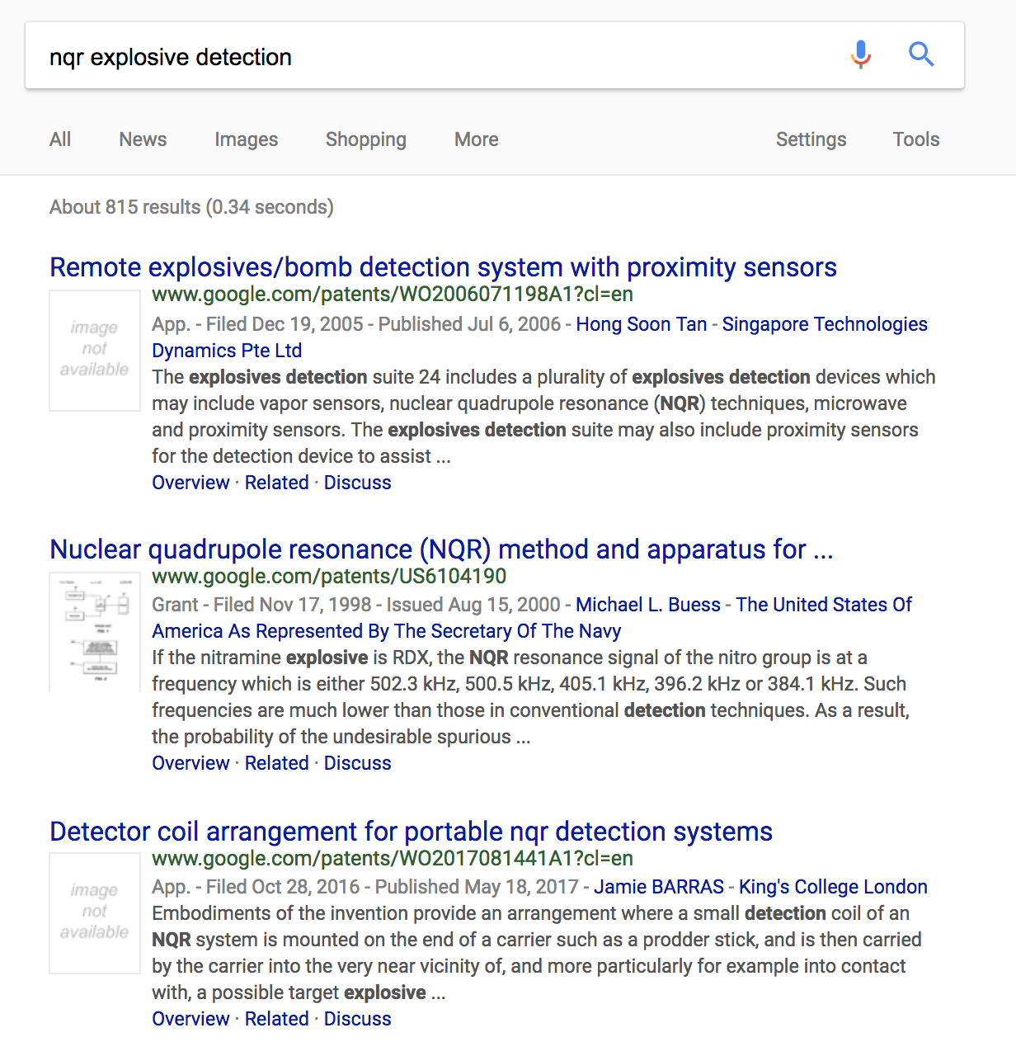
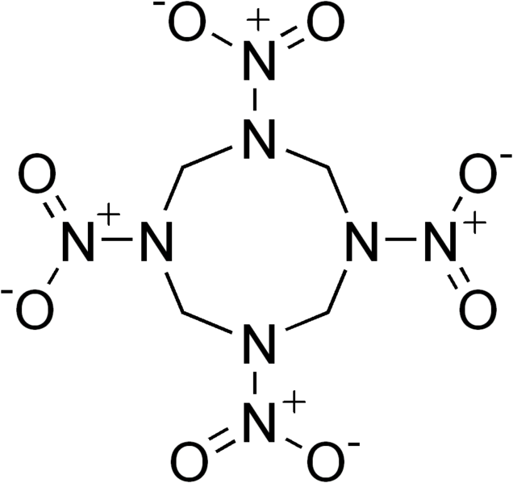
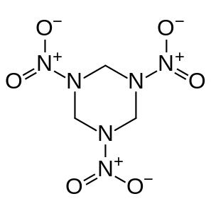
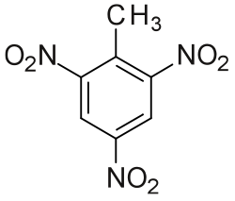
explosives detection
EFG is a chemical fingerprint
¹⁴N has quadrupole moment
US Patents 1992-2017: ~ 10²
TNT HMX RDX

Slide 4
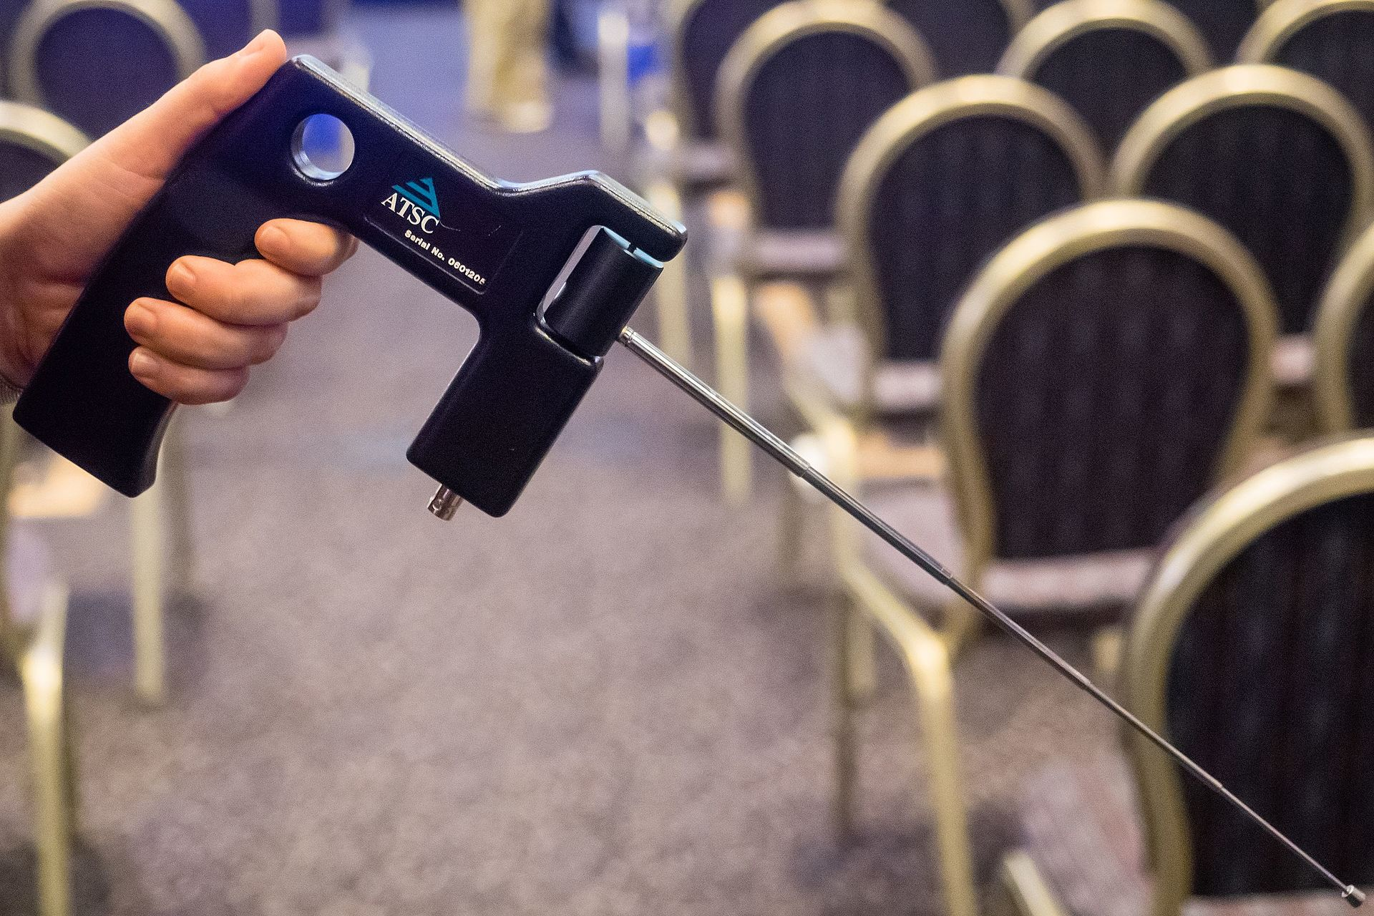
ADE 651 – fake NQR bomb detector
sold in Iraq 2008-2009
$50k/ea, total $42M
does not actually work

Slide 5
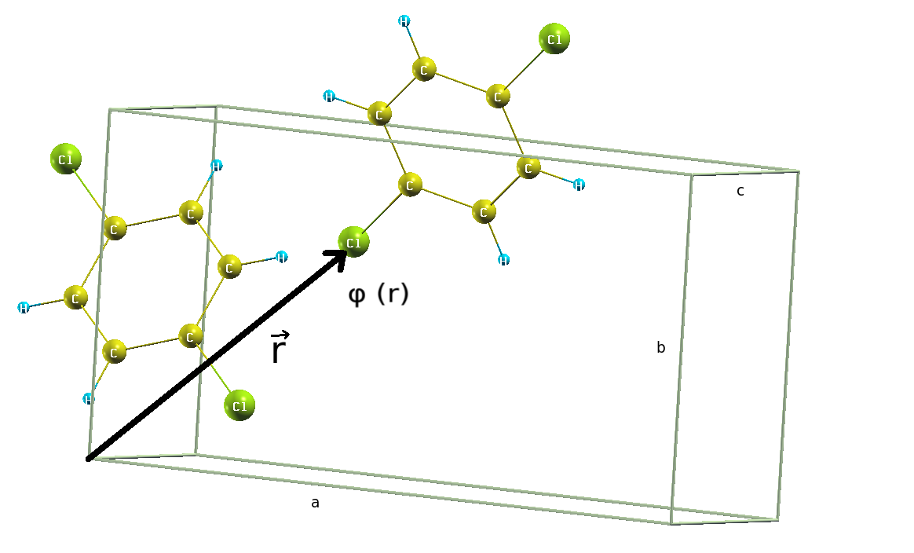
energy of charge distribution 𝜌(x) in external V(x)

Slide 6
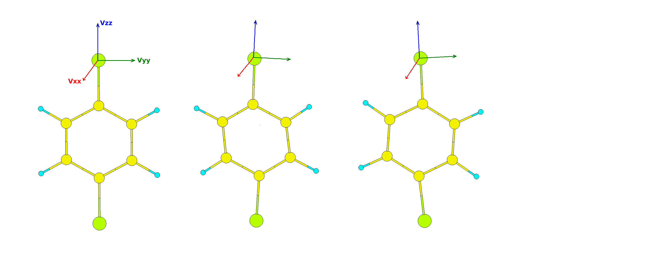
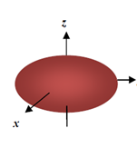
electric field gradient tensor
diagonalizable → down to 3 components
eigenvectors → principal axes X, Y, Z
Q aligns with EFG principal axes

Slide 7
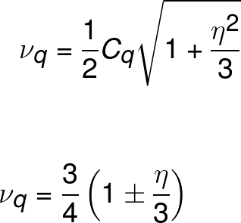
coupling constants and NQR frequencies
can get it down to two components
NQR frequencies are proportional to
ϕ_{zz} ∝ C_{q}
a factor in η
a dimensionless constant that depends on spin
with foresight, define
spin 3/2 e.g. ³⁵Cl
spin 1 e.g. ¹⁴N

Slide 8
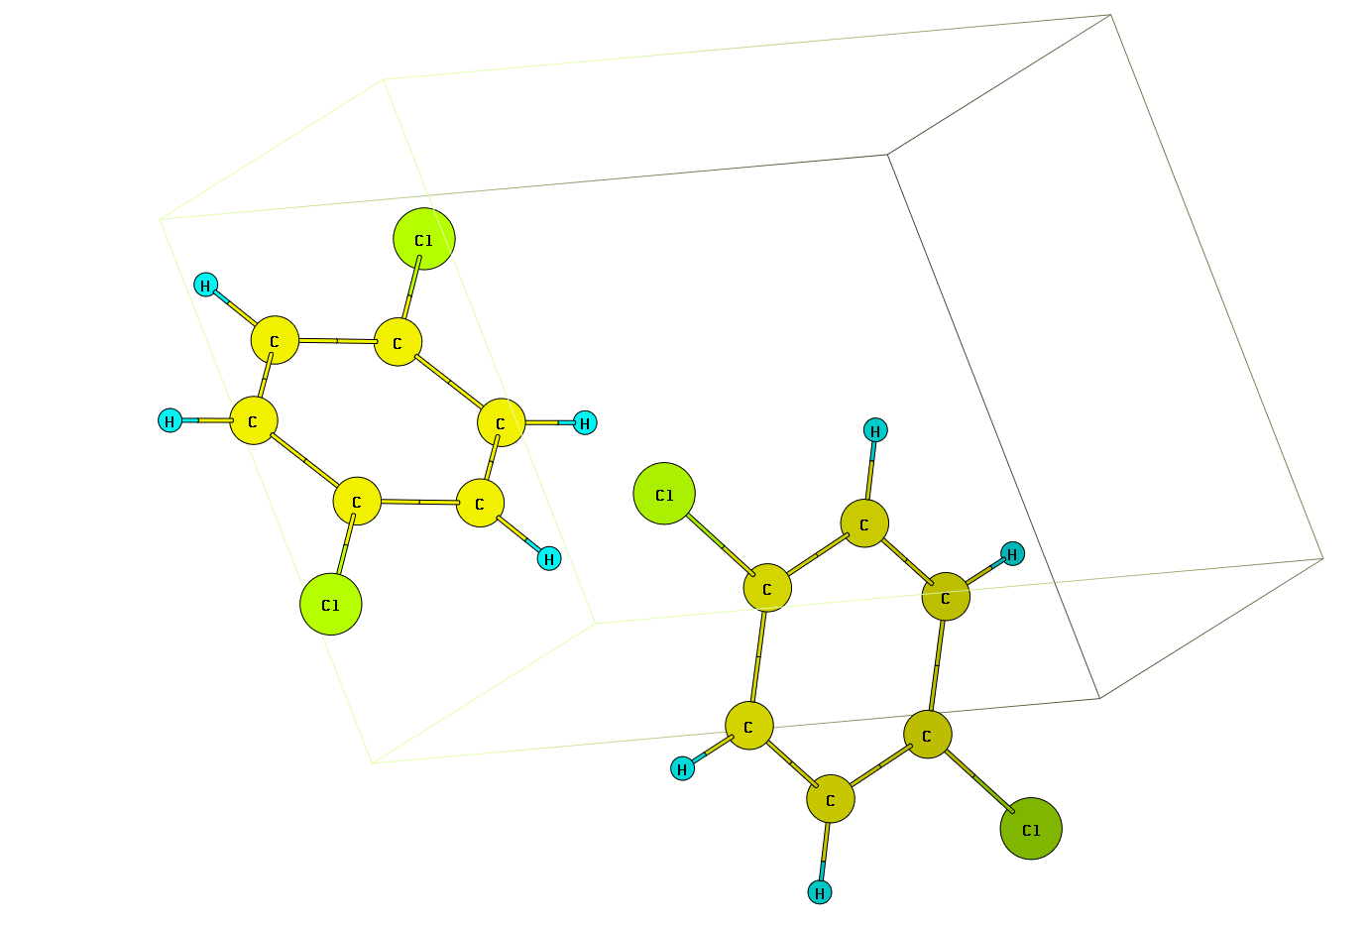
example: paradichlorobenzene
no inequivalent chlorines
³⁵Cl/³⁷Cl
75/25 abundance
have different Q
expect two lines

Slide 9
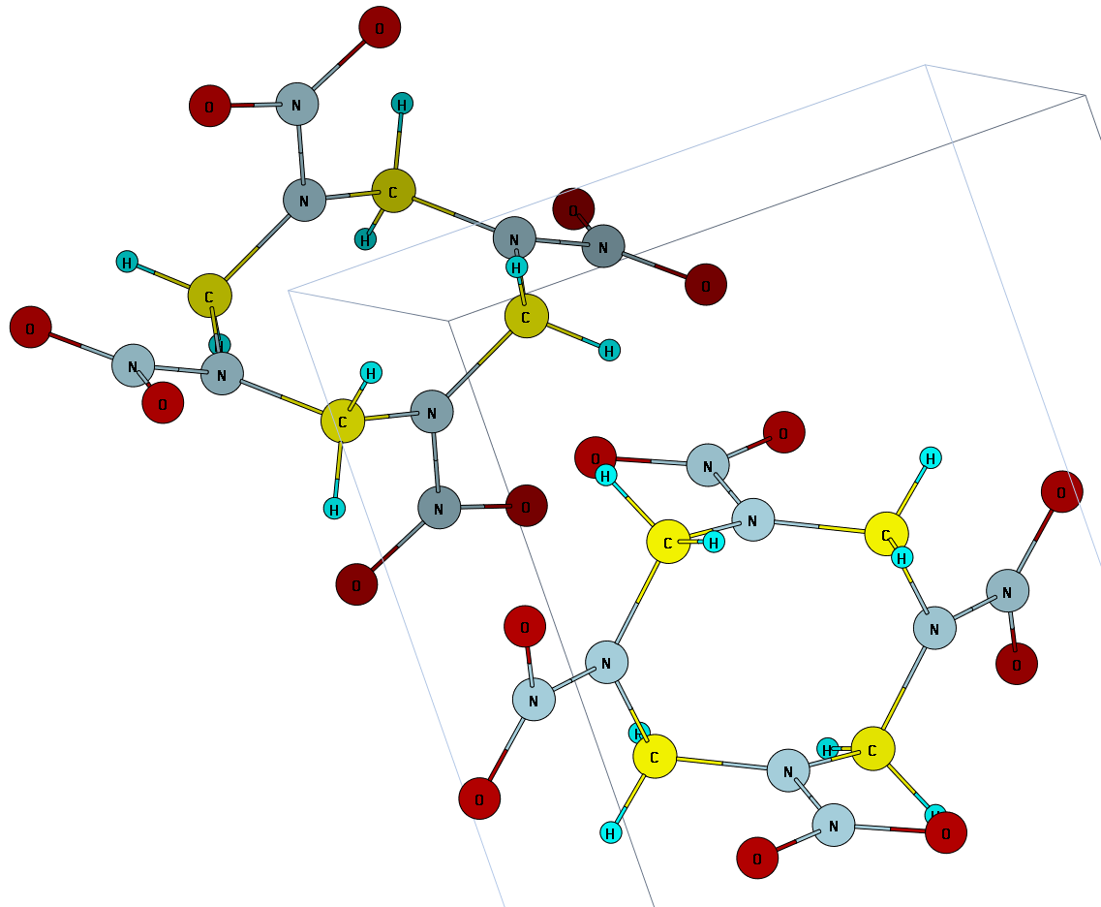
β-HMX (octogen)
two inequivalent amines
equatorial
axial
each has nitro group ∴ 4 sites
expect 8 lines since ν_{+,} ν₋

Slide 10
temperature dependence
motional effects
thermal expansion

Slide 11
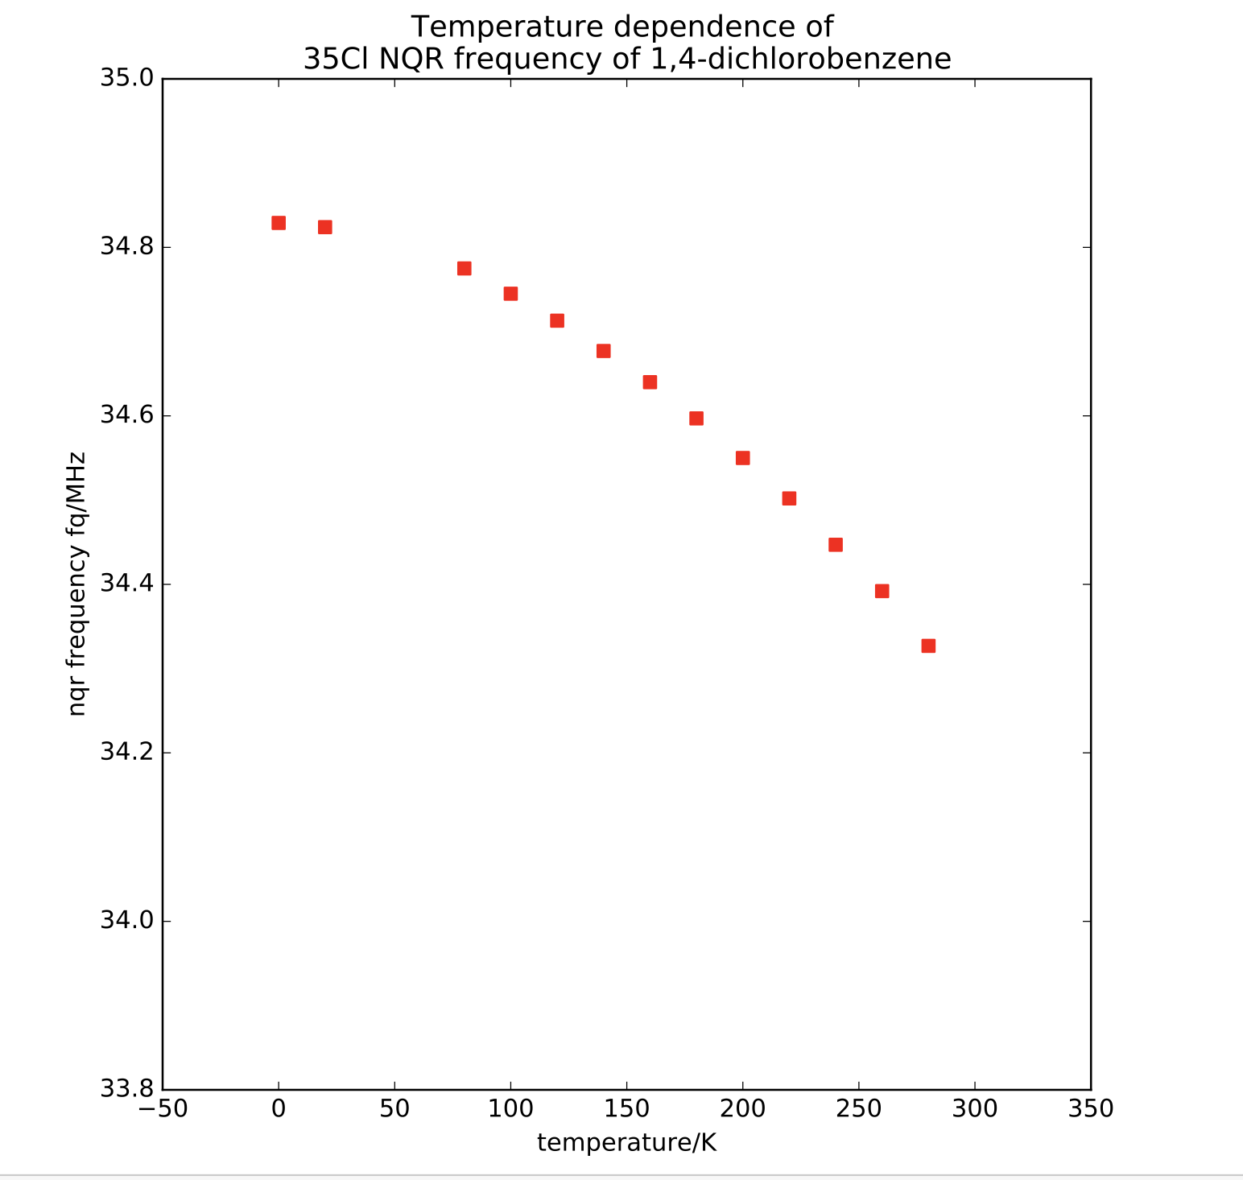
temperature dependence
increased T → decreased ν_{q}
two mechanisms:
temperature → motion
thermal expansion → new EFG

Slide 12
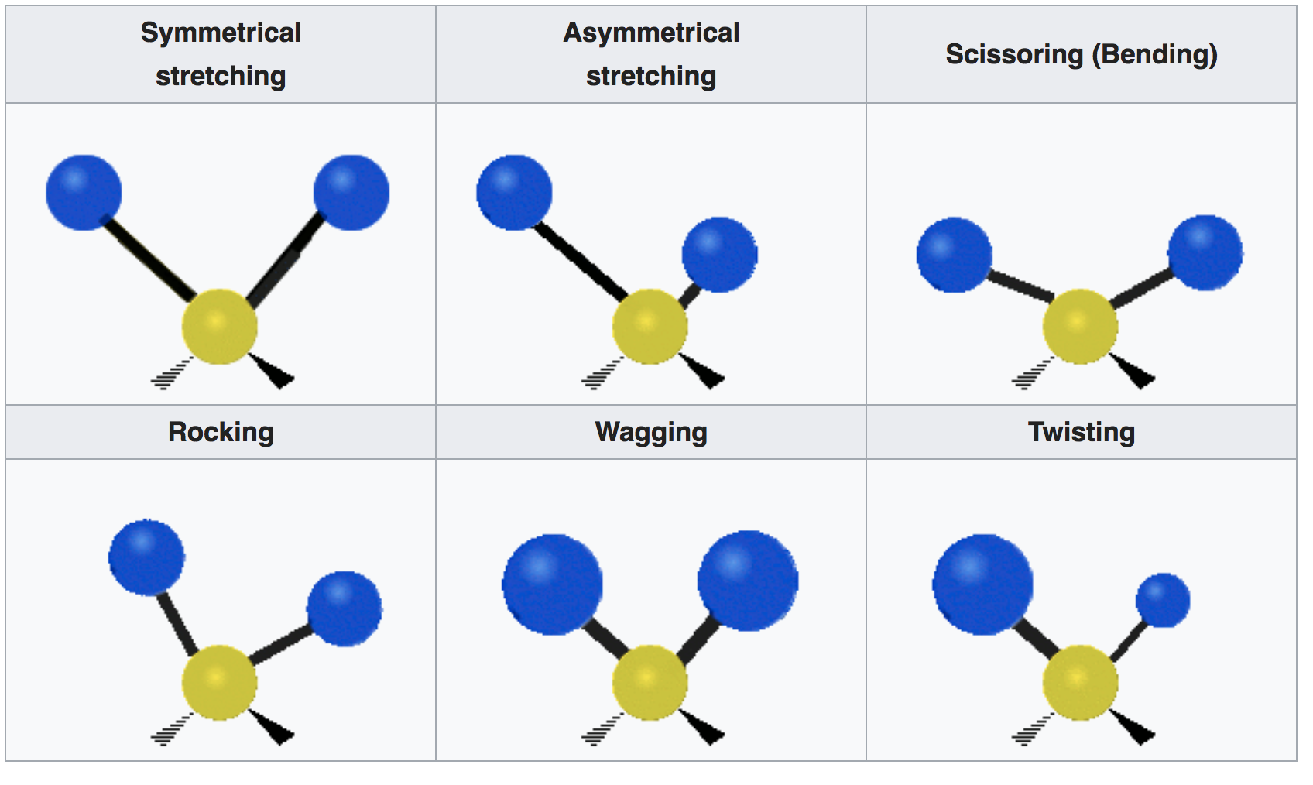
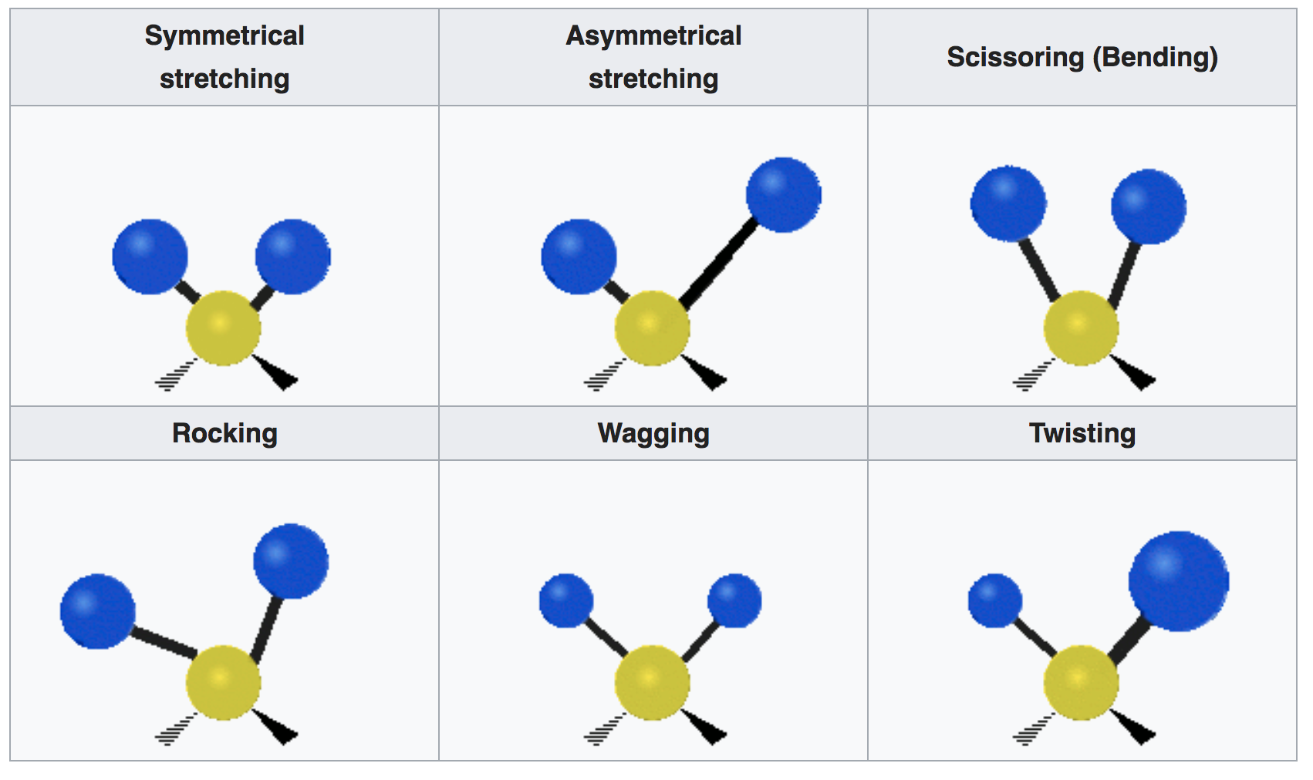
internal motions & effective EFG
3n-6 intramolecular modes
symmetrical asymmetrical scissoring
stretching stretching (bending)
rocking wagging twisting

Slide 13
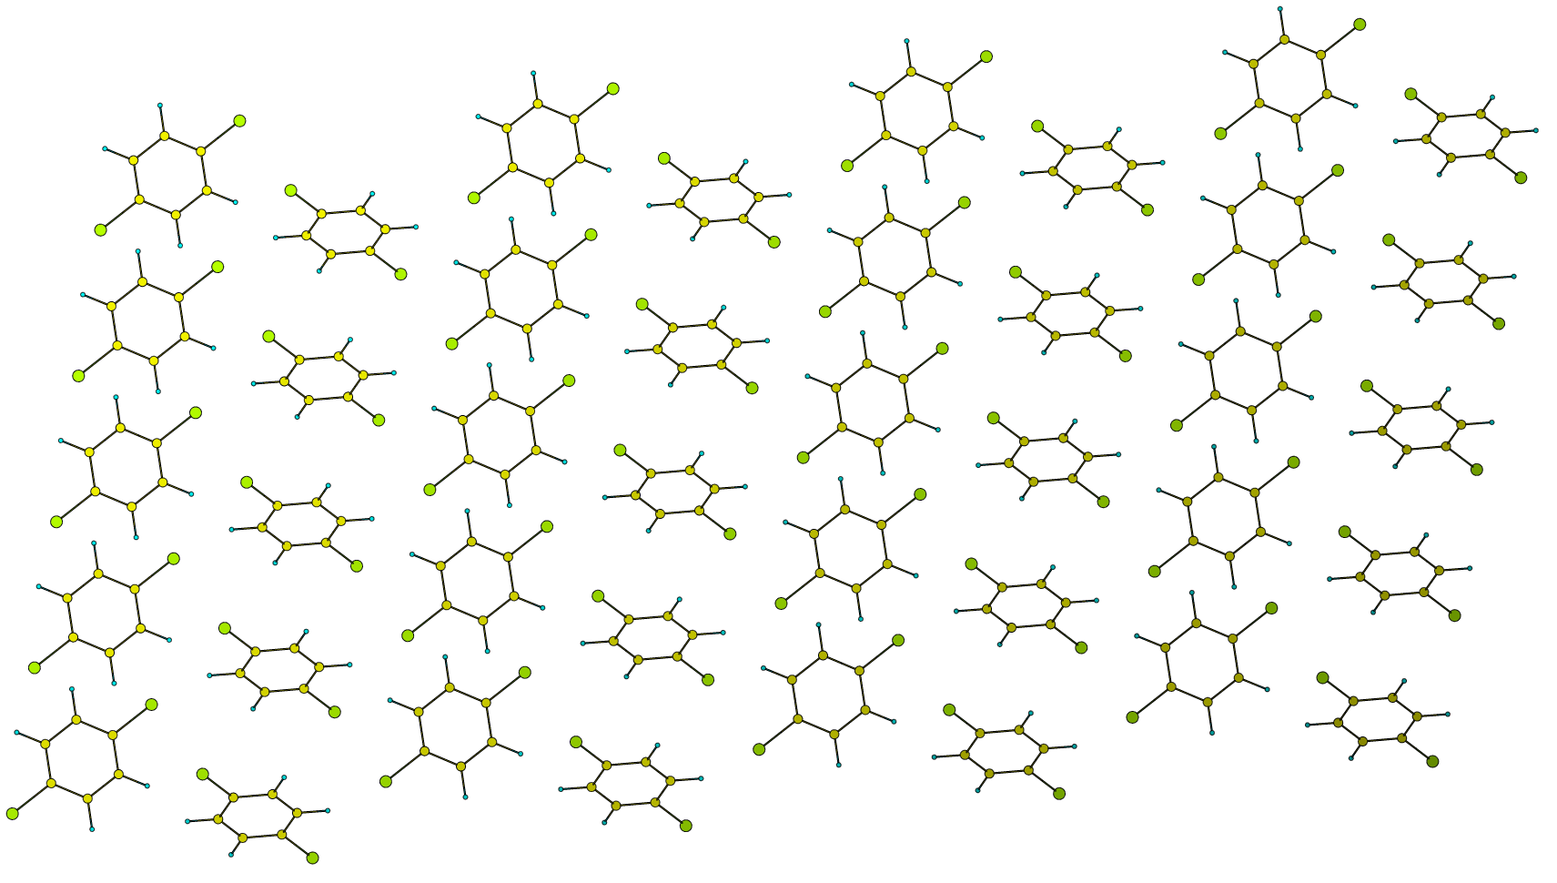
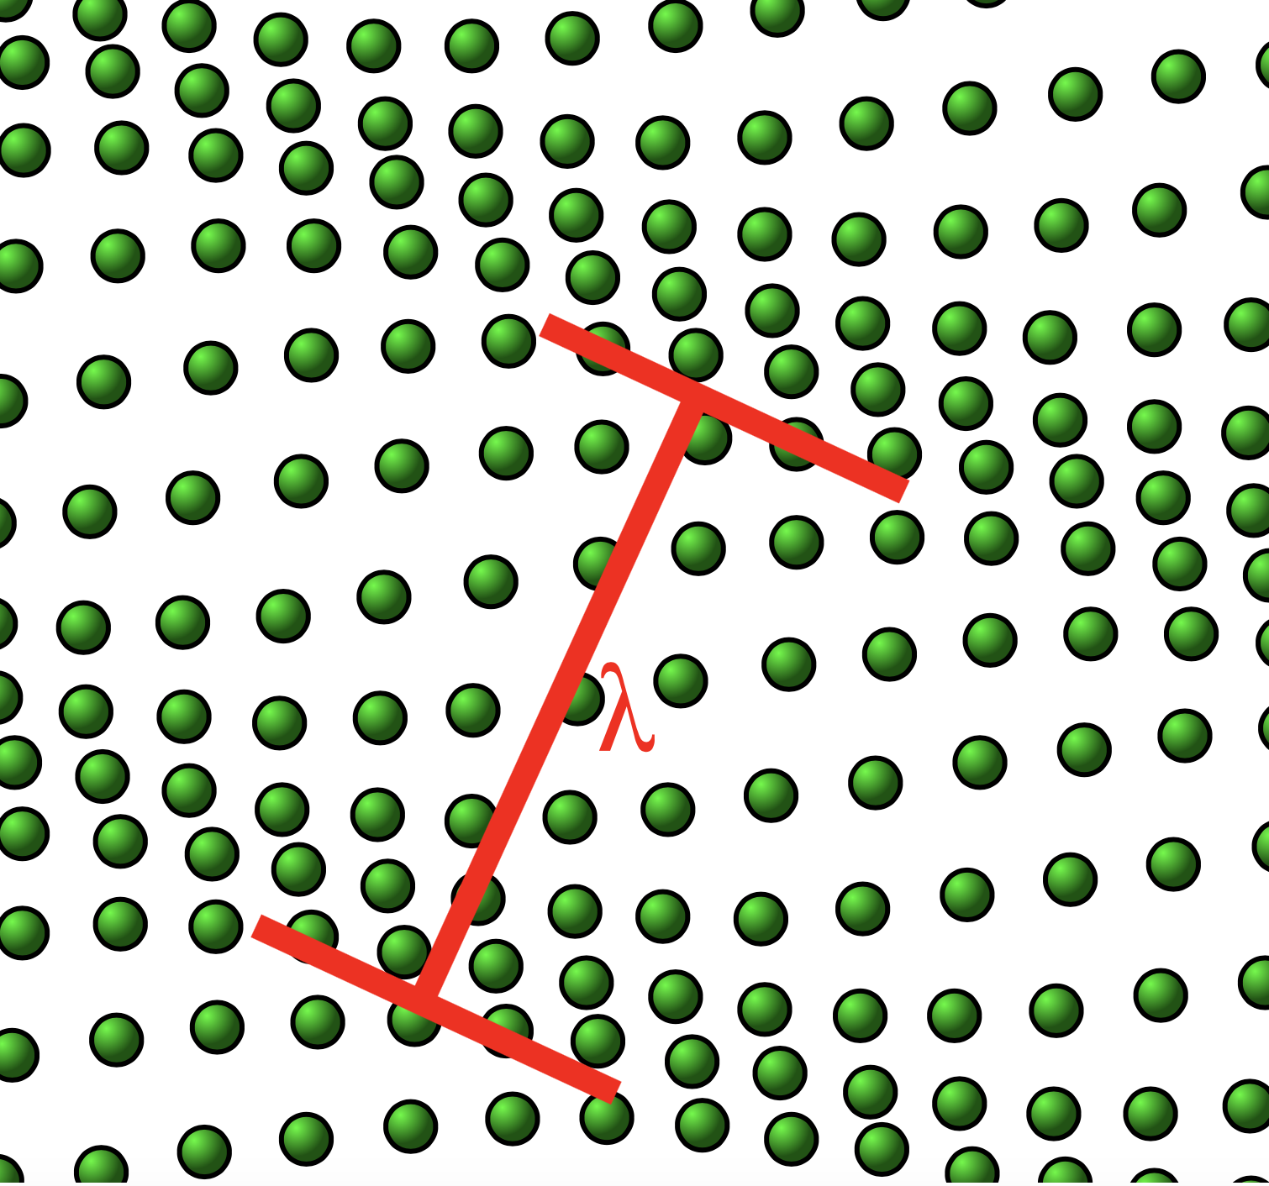
internal motions & effective EFG
intermolecular modes
acoustic & optical phonons

Slide 14
internal motions & effective EFG
vibrational modes → displacements of nucleus in EFG
fast changing EFG → nucleus sees “average EFG”
all modes: THz v.s. MHz for NQR
nuclei ”see” averaged (reduced) EFG

Slide 15
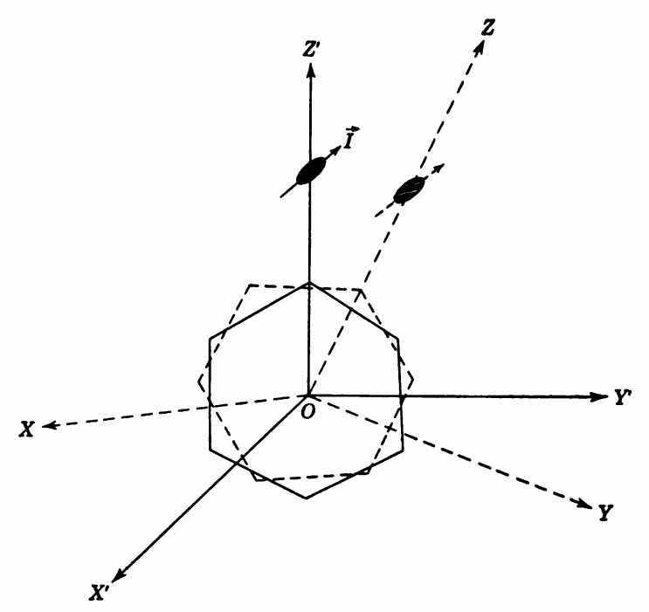
field components in perturbed system
intrinsic rotations R_{z}R_{y}R_{x}
space fixed components

Slide 16
correction to frequencies due to motions
space-fixed components
oscillators have
observed C_{q}, η

Slide 17
Bayer/BBK model
replace displacements with quantum harmonic
oscillators
disregard the term in η in the expression for the
couplings
we find
now take only first M modes where
and use approximation

Slide 18
Bayer/BBK model
b, c are fitting parameters

Slide 19
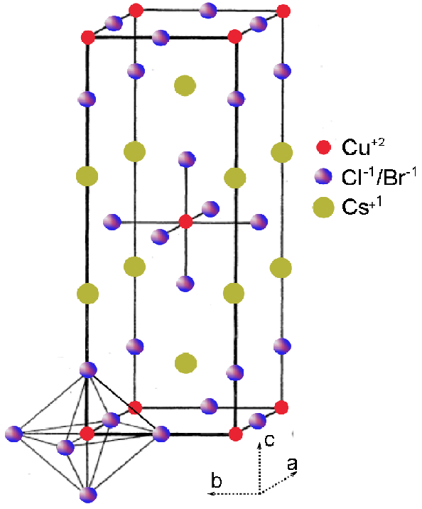
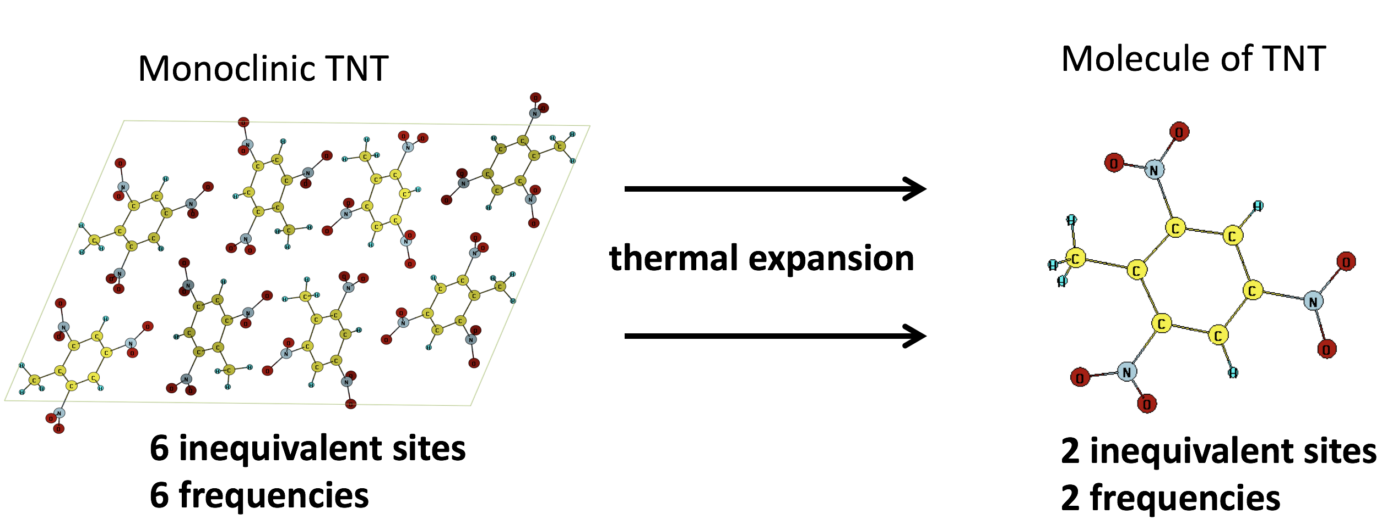
NQR volume dependence in molecular crystal
molecular crystal:
EFG increases with volume
ionic crystal: EFG tends to
zero with increased volume

Slide 20
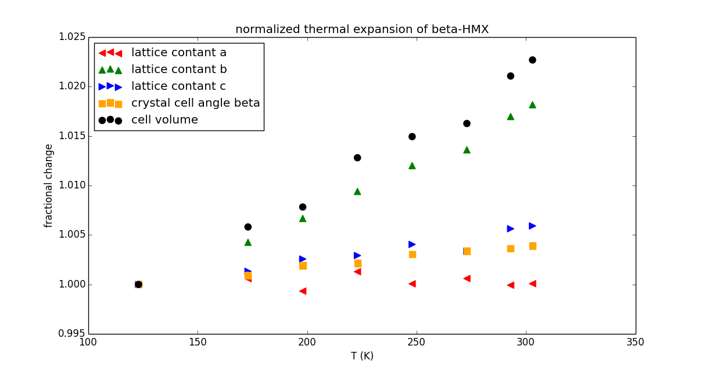
anisotropy of β-HMX thermal expansion

Slide 21
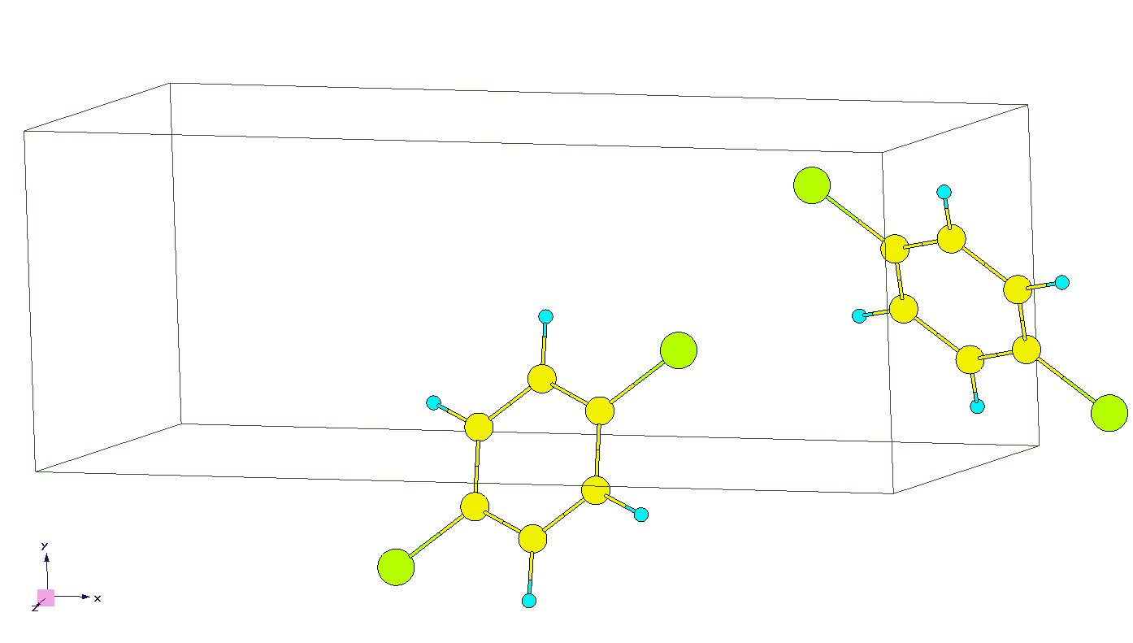
procedure
T=100K T=200K
T=225K T=250K
T=273K T=293K

Slide 22
procedure
T=100K T=200K
T=225K T=250K
T=273K T=293K

Slide 23
results - paradichlorobenzene

Slide 24
results - HMX

Slide 25



funding acknowledgement
Work supported in part by the NSF-DMR-1157490 and DOE grant DE-FG02- 02ER45995.

